Slide 1
Argument Identification
Identifying Texts Containing Arguments
Jeremy Sakovich

Slide 2
Introduction: Computational Argumentation
One of the most distinctive features of human intelligence is the ability to reason through the use of logical arguments.

Slide 3
Introduction: Computational Argumentation
One of the most distinctive features of human intelligence is the ability to reason through the use of logical arguments.
Historically the study of arguments was conducted primarily by Logicians and Philosophers.

Slide 4
Introduction: Computational Argumentation
Today Computational Argumentation is an emerging subfield in Artificial Intelligence where researchers are using computers to analyse human reasoning and arguments which occur in natural language and text.

Slide 5
Introduction: Computational Argumentation
One current major Artificial Intelligence research project in the field of Computational Argumentation is being conducted by IBM’s Project Debater team.

Slide 6
Introduction: Computational Argumentation
One current major Artificial Intelligence research project in the field of Computational Argumentation is being conducted by IBM’s Project Debater team.
The Project Debater team is engaged in research to develop an Artificial Intelligence system capable of carrying a variety of reasoning tasks including the ability for an AI to engage in meaningful debate with humans.

Slide 7
Why Argument Identification?
Argument identification is a fundamental step in reasoning.

Slide 8
Why Argument Identification?
An Artificial Intelligence system capable of engaging in reasoning must be capable of distinguishing arguments from other sorts of discourse including: instructions, unsupported opinions, lyrics, fiction, descriptions, explanations, and so forth.

Slide 9
How to Identify Arguments with Computers?

Slide 10
How to Identify Arguments with Computers?
My Approach:
Create a corpus (a set of texts) tagged manually as arguments or non-arguments.

Slide 11
How to Identify Arguments with Computers?
My Approach:
Create a corpus (a set of texts) tagged manually as arguments or non-arguments.uments.
Train a machine learning model on a subset of the corpus.

Slide 12
How to Identify Arguments with Computers?
My Approach:
Create a corpus (a set of texts) tagged manually as arguments or non-arguments.uments.
Train a machine learning model on a subset of the corpus.
Test the model on the remaining data.

Slide 13
The Data

Slide 14
The Data
LSAT practice argument questions.

Slide 15
The Data
LSAT practice argument questions.
Descartes’s Meditations.

Slide 16
The Data
LSAT practice argument questions.
Descartes’s Meditations.
United Nations Security Council Transcripts.

Slide 17
The Data
Each text was broken into paragraphs.

Slide 18
The Data
Each text was broken into paragraphs.
Then they were all manually tagged as an argument, or not.

Slide 19
The Data
In total, 605 paragraphs were tagged for computational analysis.

Slide 20
Machine Learning
A decision tree model was trained on approximately 70% of the corpus.

Slide 21
Results:
When tested, the trained model successfully identified 78% of the argument texts.

Slide 22
Limitations:
There are some limitations to the model.

Slide 23
Limitations:
The primary limitation:
A large portion of the training data was from United Nations transcripts.

Slide 24
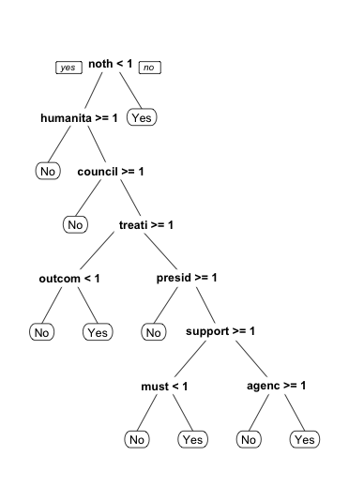
Decision Tree

Slide 25
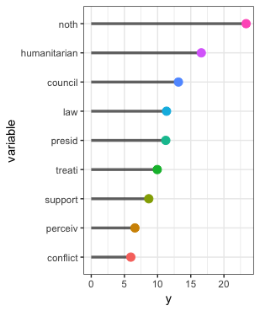
Importance of the actual words (stemmed for analysis) which were used by the trained model

Slide 26
Recommendations:
Retrain the model with a more varied dataset.

Slide 27
Recommendations:
Gather more data and retrain a model with a more varied dataset.
Try an approach which would involve creating a dictionary of common argument “indicator” words: because, therefore, consequently...

Slide 28
Conclusion:
Overall, this preliminary approach shows that it is possible to train a model capable of identifying paragraph length texts which contain arguments.
Further study into this topic is merited and could yield better results.

